Slide 1
AI in aviation
Prediction of flight delays
DIEUX Jimmy MIELCAREK Flavie MOYAUX Etienne

Slide 2

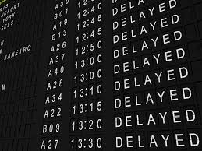

Topic introduction

Slide 3
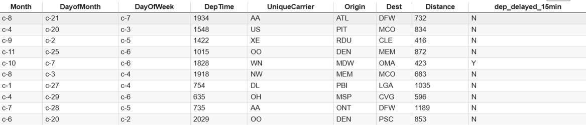
First attempt

Slide 4
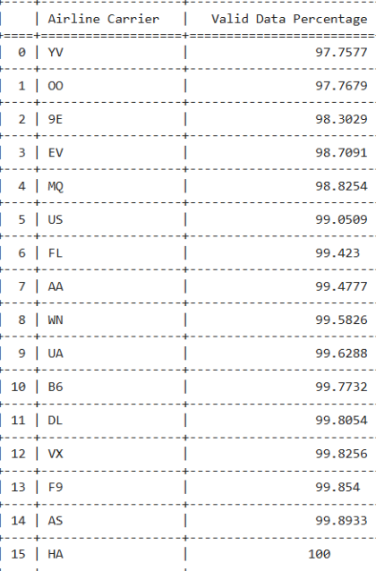
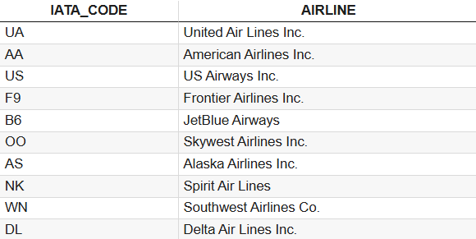
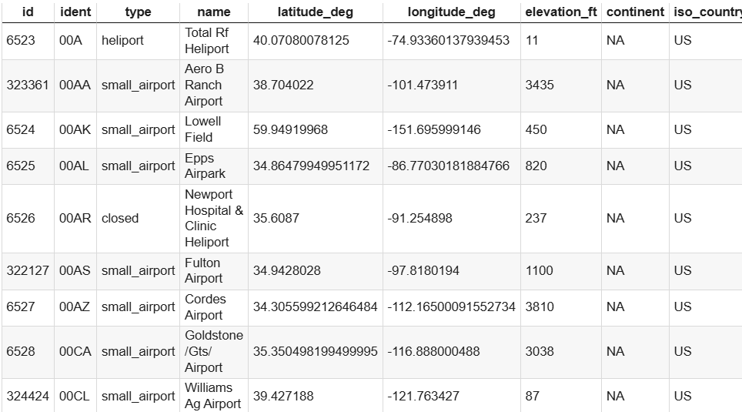
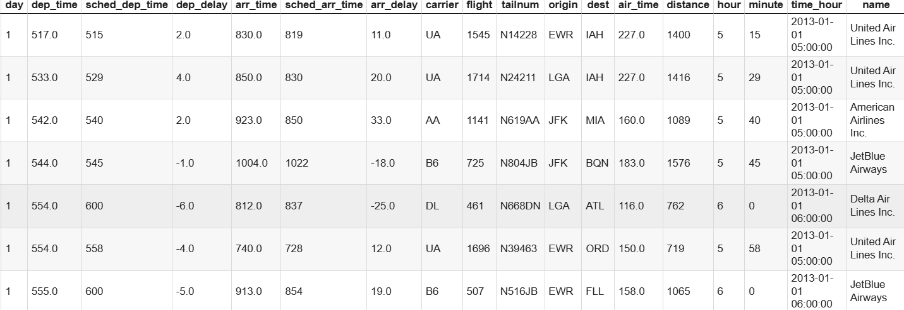
Data Processing

Slide 5

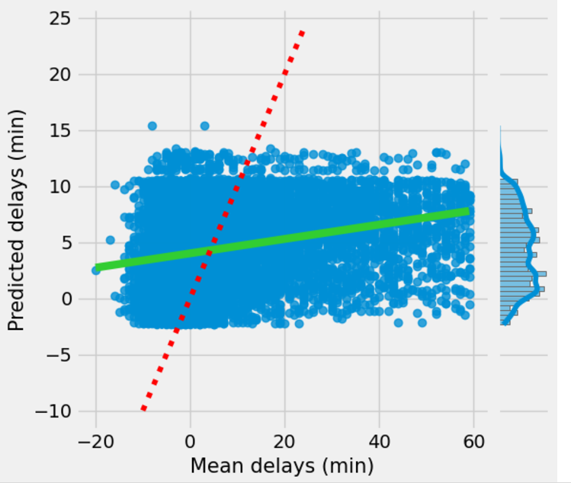
First regressor
Mean squared error
MSE : 176,24

Slide 6
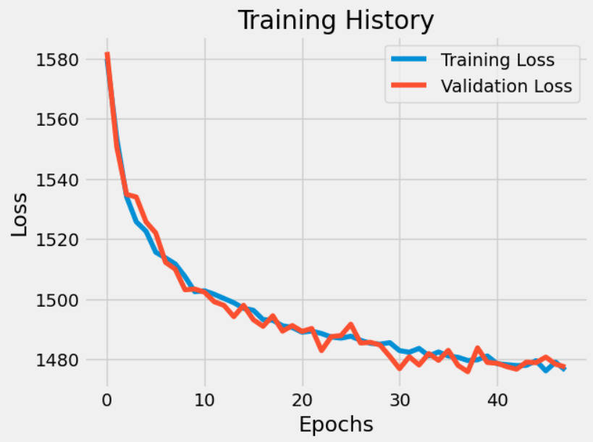
Machine learning
Mean squared error
MSE: 1475,73
Root mean squared error
RMSE: 38,42 minutes

Slide 7
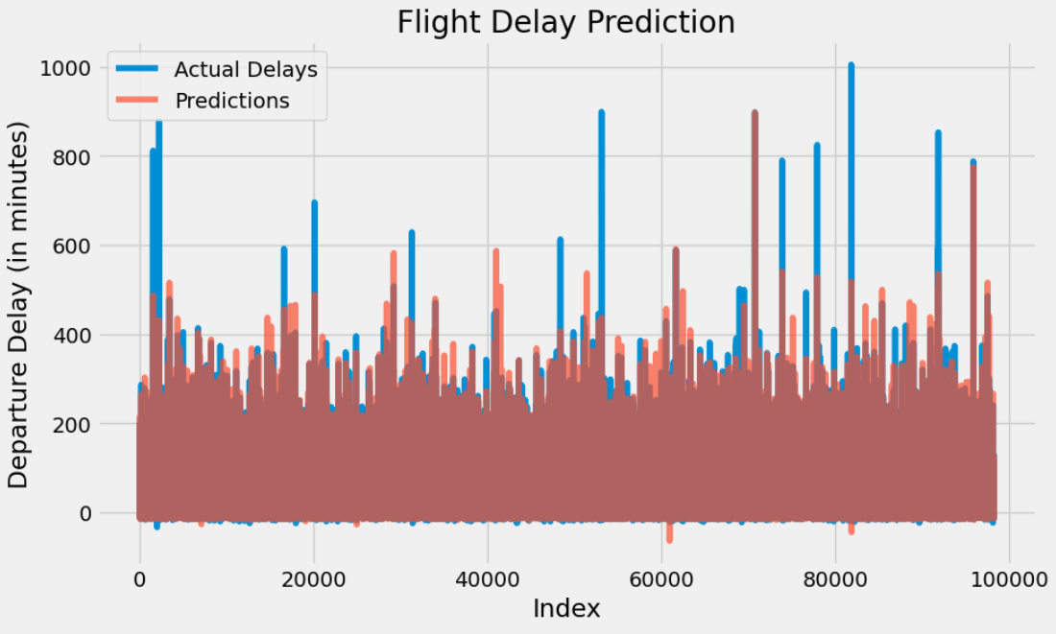
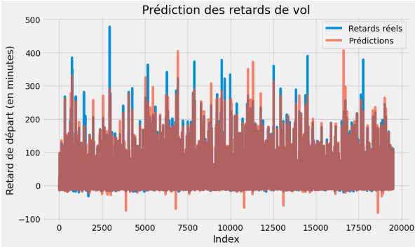
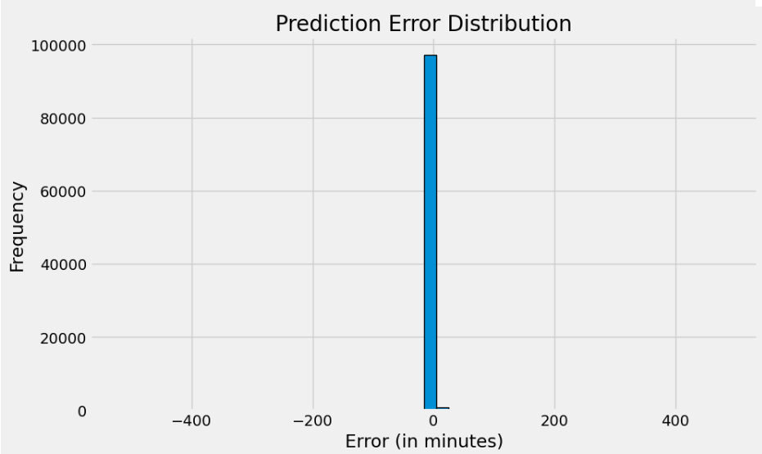
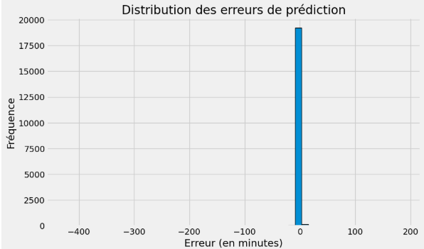
Second Regressor
Mean squared error
MSE : 27,44
Root Mean Squared Error
RMSE : 5,24
Error percentage: 4,38%

Slide 8
Conclusion
Link to our Github repository:
https://github.com/Etienne982/AI-in-aviation/blob/main/Main_Code.ipynb

